Slide 1
Labrador City
Photo Album
by Malchijah

Slide 2
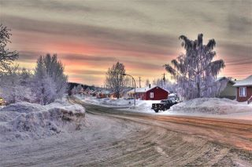

Slide 3
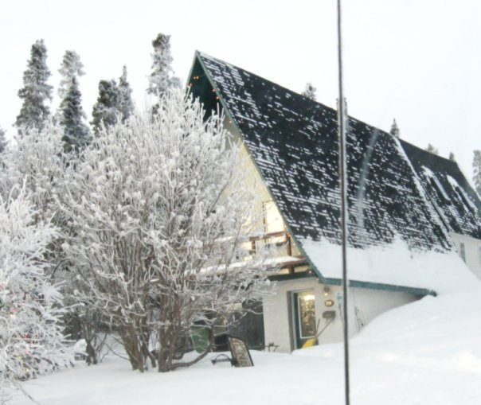
Notes:
A-frame-on-Retty

Slide 4
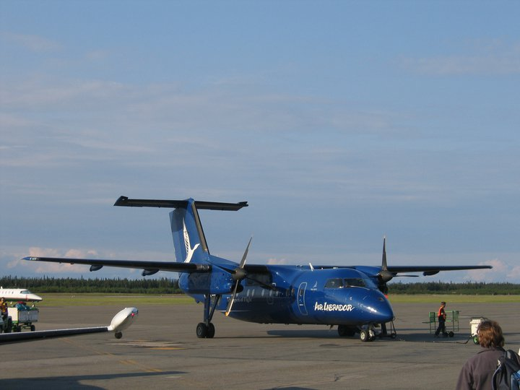
Notes:
Air-Labrador-Dash-8

Slide 5

Notes:
Air-Labrador-Logo

Slide 6
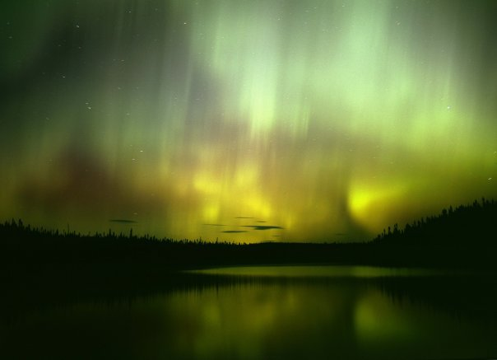
Notes:
Albert-Lake-Show

Slide 7
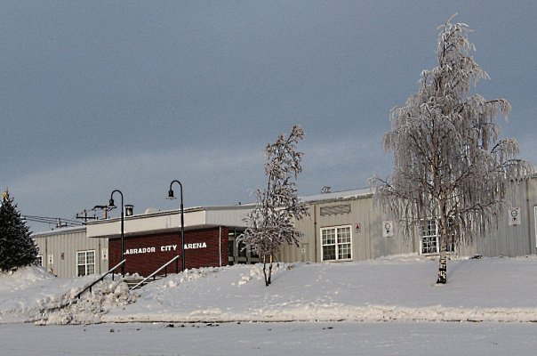
Notes:
Arena

Slide 8
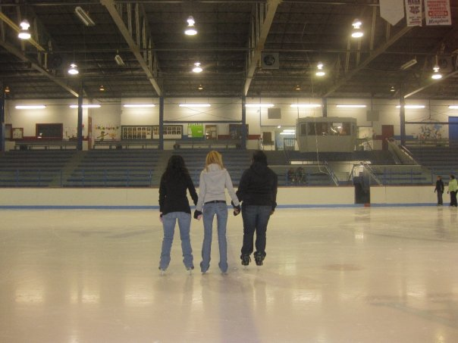
Notes:
Arena-from-ice-level

Slide 9
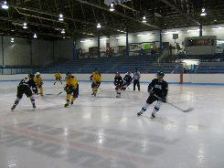
Notes:
Arena-from-players-bench

Slide 10
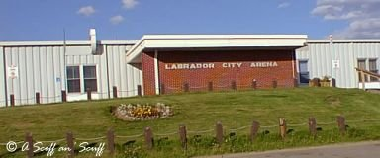
Notes:
Arena-front-door

Slide 11
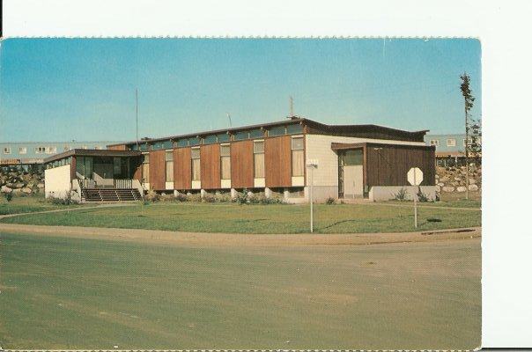
Notes:
Ashuanipi-Club

Slide 12
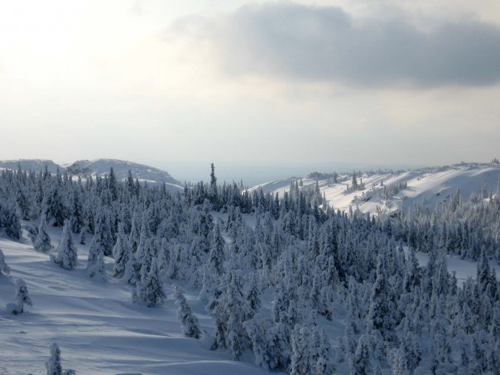
Notes:
Back-Country

Slide 13
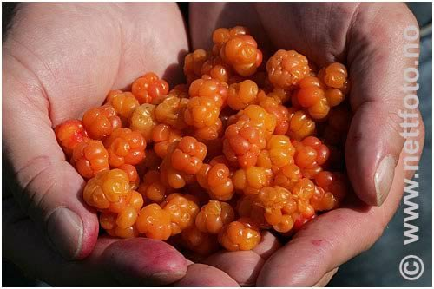
Notes:
Bakeapples-mmmmmm

Slide 14
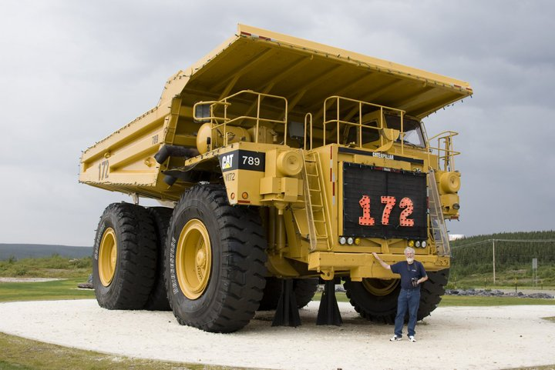
Notes:
Big-Cat

Slide 15
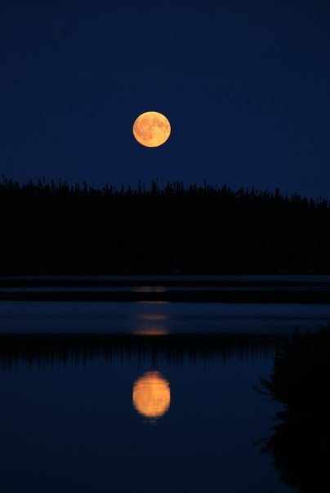
Notes:
Breathtaking-Moon

Slide 16
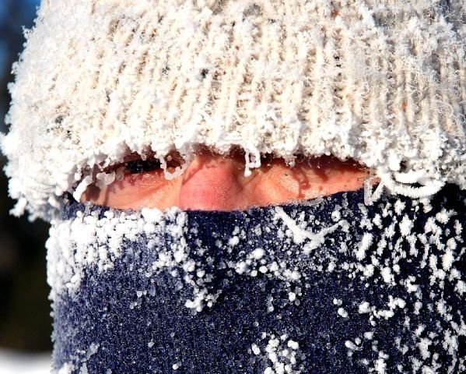
Notes:
brrrrrr

Slide 17
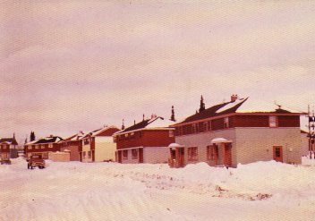
Notes:
Cabot-Cresent-1960

Slide 18
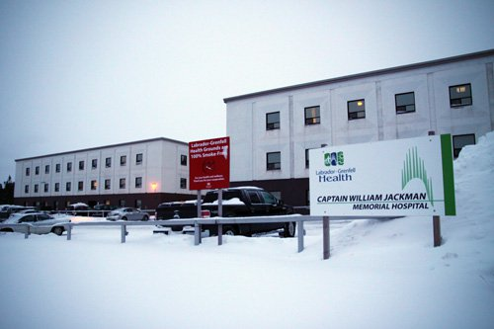
Notes:
Capt-William-Jackman-Memorial-Hospital

Slide 19
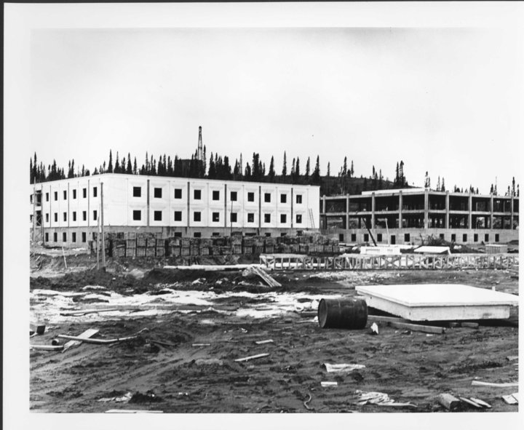
Notes:
Capt-William-Jackman-Memorial-Hospital-Contstruction

Slide 20
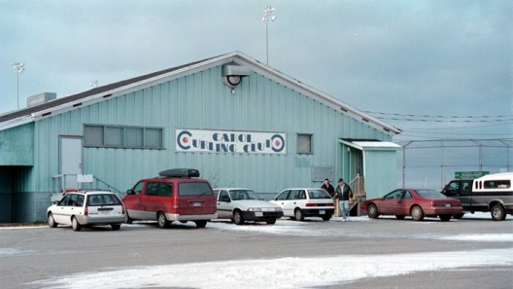
Notes:
Carol-Curling-Club

Slide 21
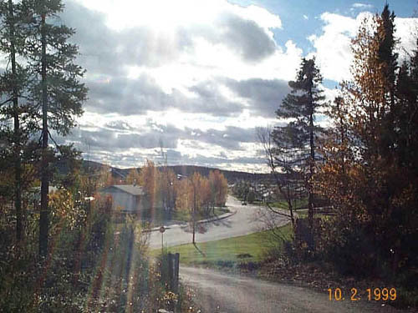
Notes:
Carol-Drive

Slide 22
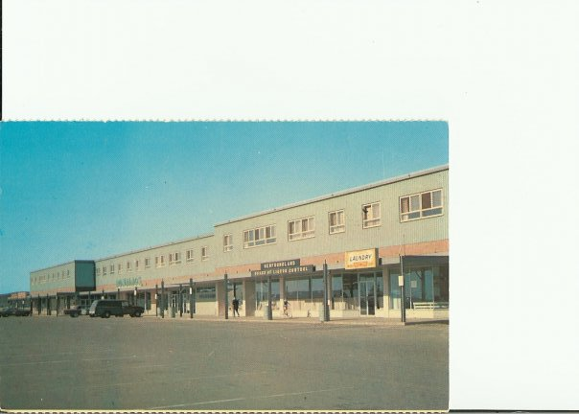
Notes:
Carol-Lake-Shopping-Center

Slide 23
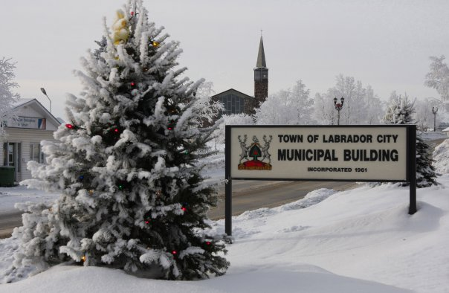
Notes:
Christmas-Morning-2009

Slide 24
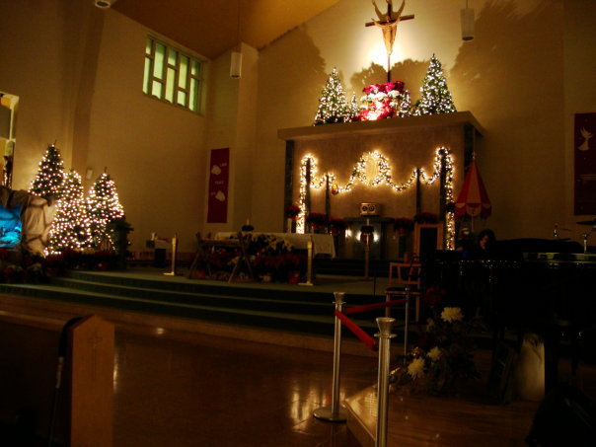
Notes:
Church-at-xmas

Slide 25
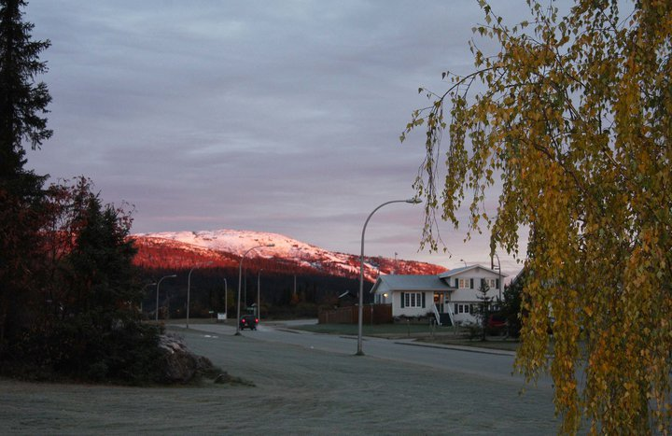
Notes:
Early-Practice-Arena-Road

Slide 26
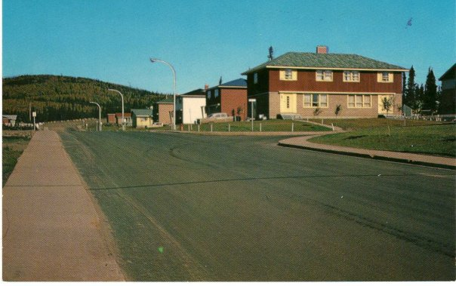
Notes:
Elizabeth-Avenue

Slide 27
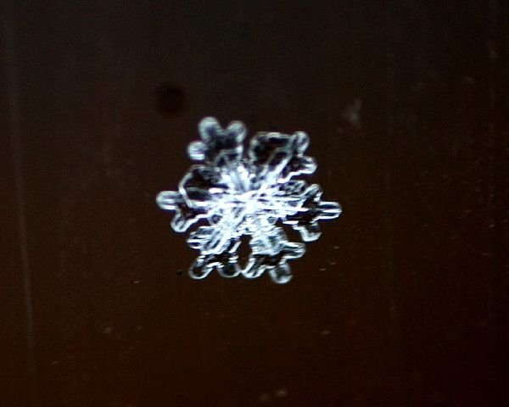
Notes:
Flake

Slide 28
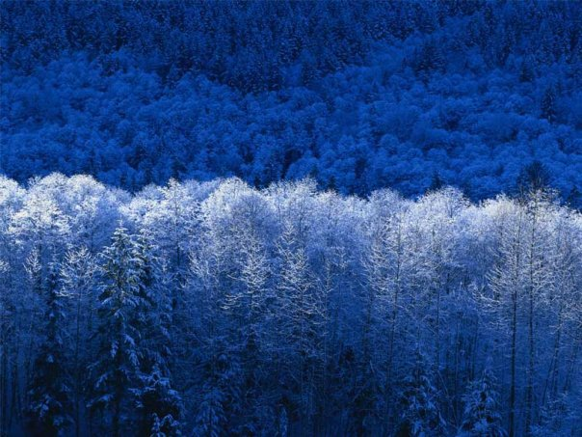
Notes:
Frosty

Slide 29
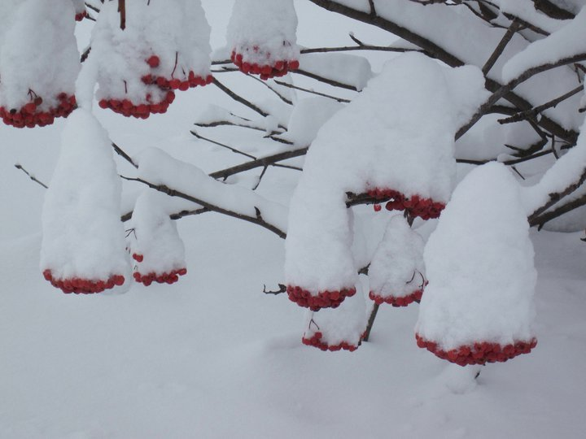
Notes:
Frozen-Dogberries

Slide 30
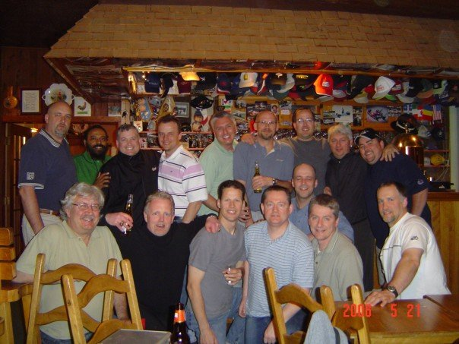
Notes:
George-Weekend-June-06-2007

Slide 31
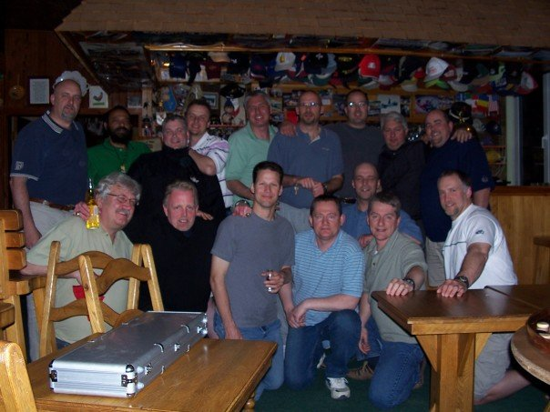
Notes:
George-Weekend-June-06-2007-2

Slide 32
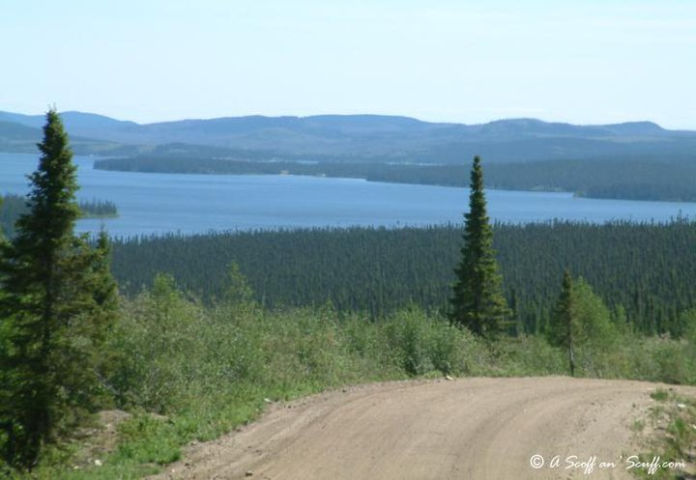
Notes:
Golf-Course-Road

Slide 33
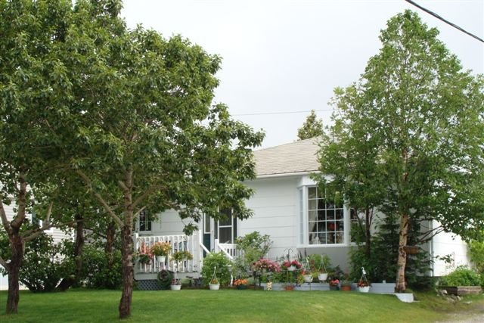
Notes:
Home-Summer

Slide 34
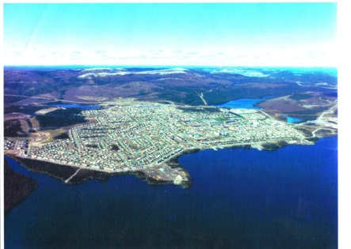
Notes:
Hometown

Slide 35
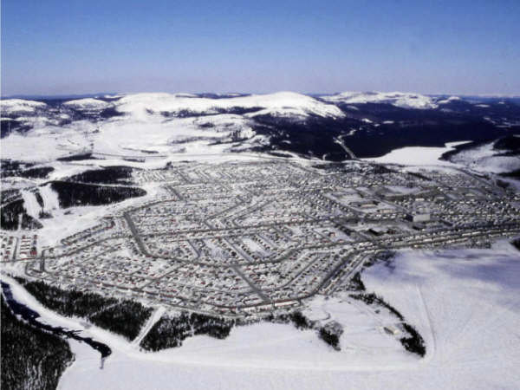
Notes:
Hometown-2

Slide 36
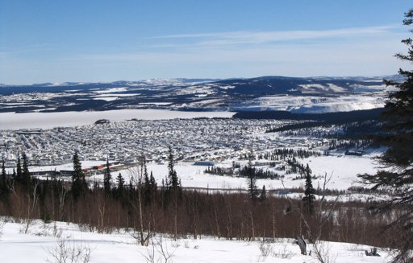
Notes:
Hometown-3

Slide 37
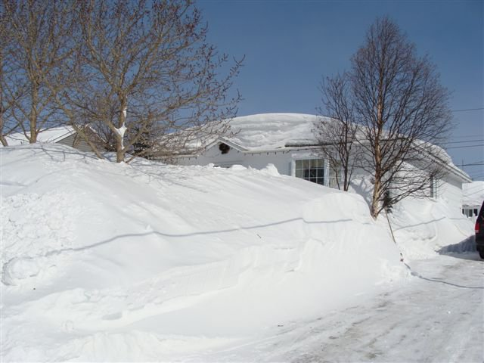
Notes:
Home-Winter

Slide 38
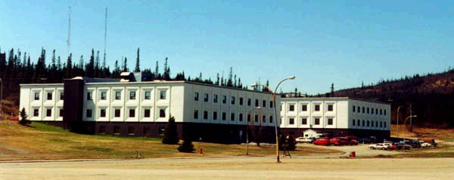
Notes:
Hospital-from-arena-parking-lot

Slide 39
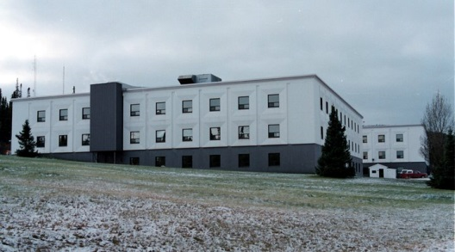
Notes:
Hospital-Side-View

Slide 40
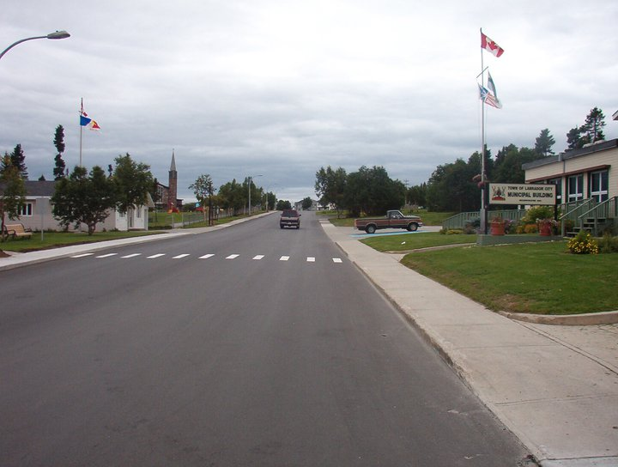
Notes:
Hudson-Drive

Slide 41
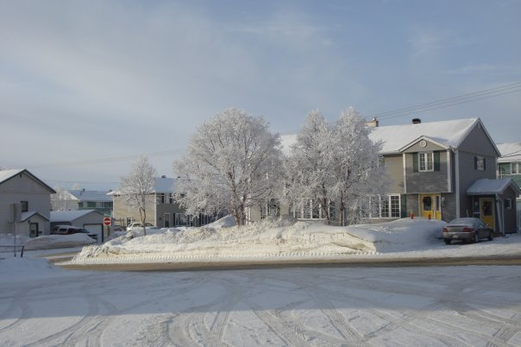
Notes:
Icy-Scene

Slide 42
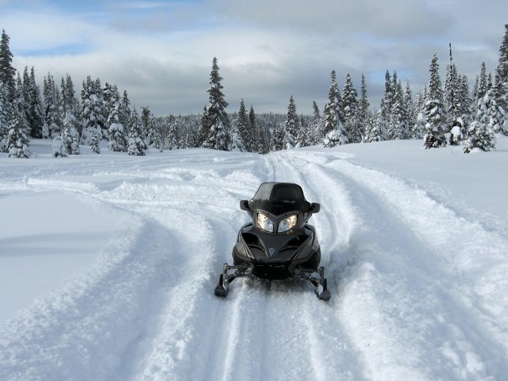
Notes:
Invader

Slide 43
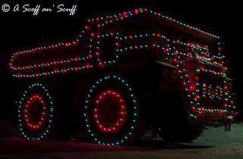
Notes:
IOC-Xmas-Truck

Slide 44
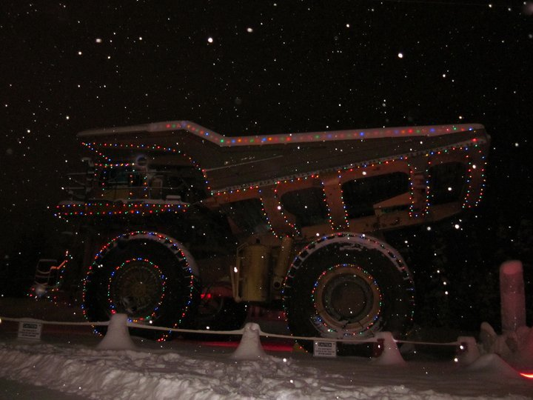
Notes:
IOC-Xmas-Truck-2

Slide 45
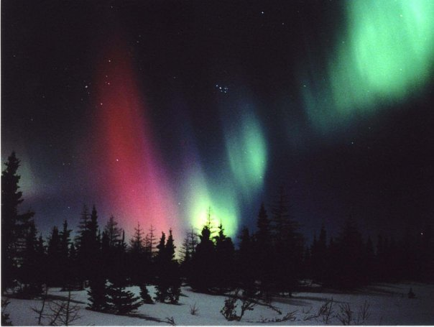
Notes:
Javelin-Road-Sky-Show

Slide 46
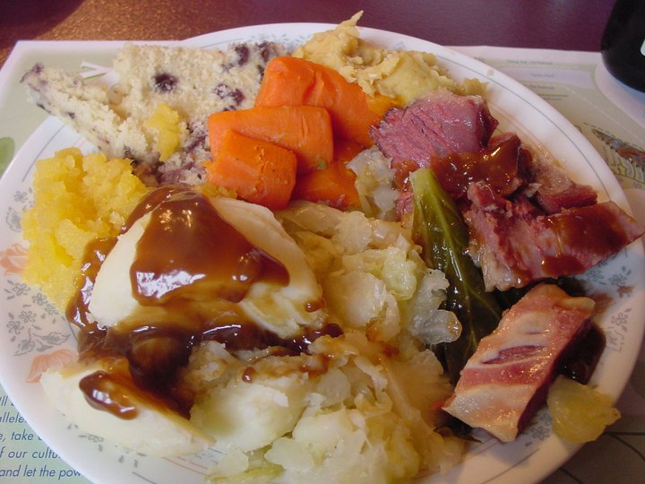
Notes:
Jiggs-Dinner-with-Salt-Beef

Slide 47
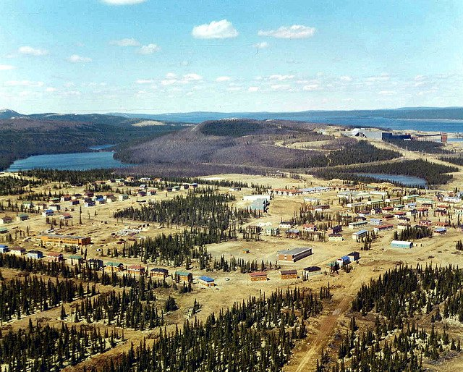
Notes:
Lab-City-1962

Slide 48
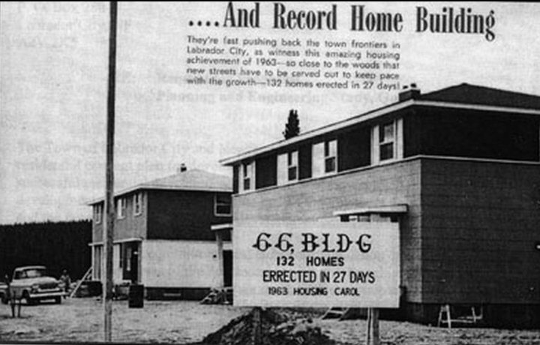
Notes:
LabCity-1963-Home-Building-Record

Slide 49
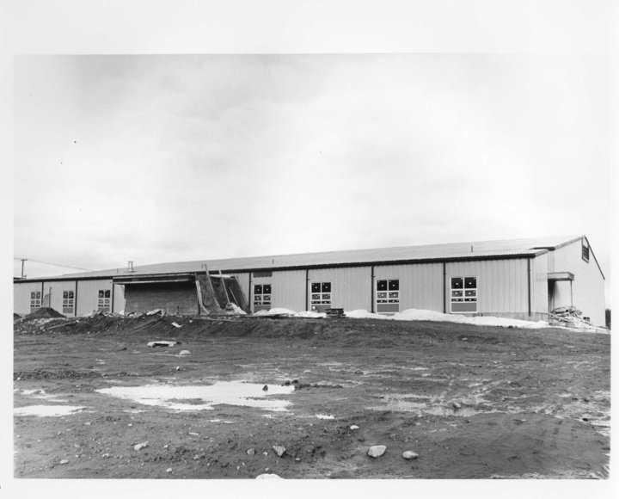
Notes:
LabCity-Arena

Slide 50
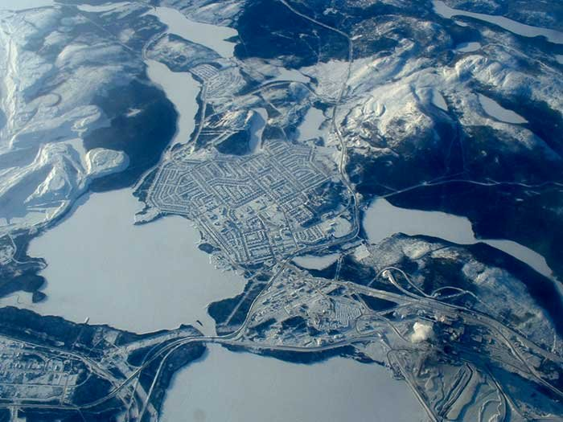
Notes:
Labrador City from on-high

Slide 51

Notes:
Labrador Colors

Slide 52
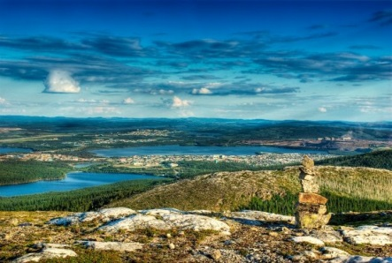
Notes:
Labrador Colours

Slide 53

Notes:
Labrador Flag

Slide 54
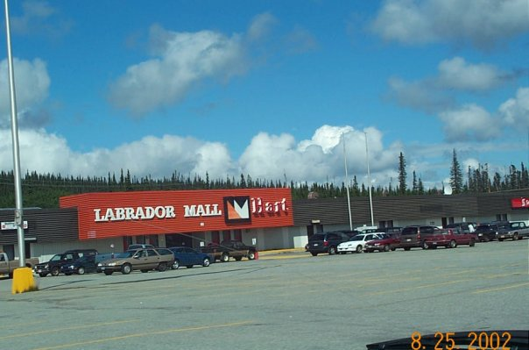
Notes:
Labrador Mall

Slide 55

Notes:
LabradorCity-Arial1

Slide 56

Notes:
LabradorCity-Arial2

Slide 57

Notes:
LabradorCity-Arial3

Slide 58

Notes:
LabradorCity-Arial4

Slide 59

Notes:
LabradorCity-Arial5

Slide 60

Notes:
LabradorCity-Arial-Mines

Slide 61

Notes:
LabradorCity-Arial-Nice

Slide 62

Notes:
LabradorCity-Arial-Nice2

Slide 63

Notes:
LabradorCity-Arial-Nice3

Slide 64

Notes:
LabradorCity-Arial-Winter

Slide 65

Notes:
LabradorCity-Arial-Winter2

Slide 66

Notes:
LabradorCity-Arial-Winter3

Slide 67

Notes:
LabradorCity-AshiwanipiClub

Slide 68

Notes:
LabradorCity-CatholicChurch

Slide 69

Notes:
LabradorCity-CatholicChurch1

Slide 70

Notes:
LabradorCity-CatholicChurch2

Slide 71

Notes:
LabradorCity-CatholicChurch3

Slide 72

Notes:
LabradorCity-CatholicChurch-Winter

Slide 73

Notes:
LabradorCity-CEMcManus

Slide 74

Notes:
LabradorCity-CrystalFalls

Slide 75

Notes:
LabradorCity-dave1

Slide 76

Notes:
LabradorCity-Ed's-backyard2

Slide 77

Notes:
LabradorCity-EssoGasStation

Slide 78

Notes:
Labrador-City-from different view

Slide 79

Notes:
LabradorCity-georges-weekend-001

Slide 80

Notes:
LabradorCity-georges-weekend-004

Slide 81

Notes:
LabradorCity-georges-weekend-009

Slide 82

Notes:
LabradorCity-georges-weekend-021

Slide 83

Notes:
LabradorCity-Grenfell-Hotel

Slide 84

Notes:
LabradorCity-Husky

Slide 85

Notes:
LabradorCity-Lab West-Reunion 2002-Jarges-Pub

Slide 86

Notes:
LabradorCity-Land

Slide 87

Notes:
LabradorCity-lcc

Slide 88

Notes:
LabradorCity-lcc1

Slide 89

Notes:
LabradorCity-LCC2

Slide 90

Notes:
LabradorCity-Lcity01

Slide 91

Notes:
LabradorCity-Lcity02

Slide 92

Notes:
LabradorCity-Lcity04

Slide 93

Notes:
LabradorCity-Lcity05

Slide 94

Notes:
LabradorCity-menihek

Slide 95

Notes:
LabradorCity-NightTime

Slide 96

Notes:
LabradorCity-Pellet-Plant

Slide 97

Notes:
LabradorCity-QuartziteLake2

Slide 98

Notes:
LabradorCity-QuartziteLake3

Slide 99

Notes:
LabradorCity-QuarziteLake

Slide 100

Notes:
LabradorCity-RoyalTheater

Slide 101

Notes:
LabradorCity-Scenic

Slide 102

Notes:
LabradorCity-Scenic2

Slide 103

Notes:
LabradorCity-Scenic3

Slide 104

Notes:
LabradorCity-Scenic4

Slide 105

Notes:
LabradorCity-smallwood

Slide 106

Notes:
LabradorCity-smokeymt

Slide 107

Notes:
LabradorCity-Supper2-at-Tamarack

Slide 108

Notes:
LabradorCity-Tamarack

Slide 109

Notes:
LabradorCity-Tamarack-Golf-Club

Slide 110

Notes:
LabradorCity-TanyaLake

Slide 111

Notes:
LabradorCity-Town

Slide 112

Notes:
LabradorCity-Town-ElizabethDr

Slide 113

Notes:
LabradorCity-TrainingCenter

Slide 114

Notes:
LabradorCity-WaterTower

Slide 115

Notes:
LCC-High-School-Soccer-Champs-October-07-1981

Slide 116

Notes:
LCC-Old-High-School

Slide 117

Notes:
LCC-old-pic

Slide 118

Notes:
LCC-School-Cancellation-Letter

Slide 119

Notes:
LC-Police

Slide 120

Notes:
LC-Town-Map

Slide 121

Notes:
Menihek-High

Slide 122

Notes:
Moonlight-Aurora-Walsh-river

Slide 123

Notes:
MRC-in-Quebec

Slide 124

Notes:
MRC-Labrador-City-Softball

Slide 125

Notes:
MRC-Labrador-City-Softball-2

Slide 126

Notes:
MT-2004-1

Slide 127

Notes:
MT-2004-2

Slide 128

Notes:
MT-2004-3

Slide 129

Notes:
MT-2004-4-Anthony_McNeil-Greg_Peddle

Slide 130

Notes:
MT-2004-5

Slide 131

Notes:
MT-2004-6

Slide 132

Notes:
MT-2004-7

Slide 133

Notes:
NFLD-Labrador-Republic

Slide 134

Notes:
NFLD-Nuther-Country

Slide 135

Notes:
Nordic-Ski-Club

Slide 136

Notes:
Northern-Lights

Slide 137

Notes:
Notre-Dame-Academy

Slide 138

Notes:
One-Billion-Tonnes

Slide 139

Notes:
On-top-of-ole-Smokey

Slide 140

Notes:
Ooops

Slide 141

Notes:
Our-Lady-of-Perpetual-Help-Cathedral

Slide 142

Notes:
Our-Lady-of-Perpetual-Help-Catholic-Church

Slide 143

Notes:
Overlooking-Town

Slide 144

Notes:
Poppies-just-a-cool-pic

Slide 145

Notes:
Quartzite-Lake

Slide 146

Notes:
RC-Church-at-night

Slide 147

Notes:
RC-Church-Black-and-White

Slide 148

Notes:
Red-Sky-at-night

Slide 149

Notes:
Royal-Theatre

Slide 150

Notes:
School-cancellation-letter-for-the-cold-weather

Slide 151

Notes:
Smokey-Mountain-Trail

Slide 152

Notes:
Snob-Hill

Slide 153

Notes:
Snob-Hill-2

Slide 154

Notes:
Sunset

Slide 155

Notes:
Sunset-on-Our-Lady

Slide 156

Notes:
Tanya-Lake-Beach

Slide 157

Notes:
The-Big-Land

Slide 158

Notes:
The-Embassey

Slide 159

Notes:
The-Northern-Lights-of-Labrador

Slide 160

Notes:
Town-Crest

Slide 161

Notes:
Town-Crest-Coat-of-Arms

Slide 162

Notes:
Town-from-Hillside

Slide 163

Notes:
Town-of-Carol-Lake-now-Lab-City

Slide 164

Notes:
Wabush-Lake

Slide 165

Notes:
Wabush-Rec-Center-and-Arena

Slide 166

Notes:
Wal-Mart-in-Winter

Slide 167

Notes:
Walsh-River-between-Duley-and-Roaders-Point

Slide 168

Notes:
Water-Tower

Slide 169

Notes:
Wayyy-back-of-Smokey

Slide 170

Notes:
Welcome-Sign

Slide 171

Notes:
White-on-White

Slide 172

Notes:
Winter

Slide 173

Notes:
WOW-Northern-Lights

Slide 174

Notes:
Xmas-2009

